Slide 1
Osher Lifelong Learning Institute, Winter 2026
The Economics of Public Policy Issues
American University
Host: Geoffrey Woglom, Director
National Economic Education Delegation

Slide 2
National Economic Education Delegation
Vision
  One day, the public discussion of policy issues will be grounded in an accurate perception of the underlying economic principles and data.
Mission
  NEED unites the skills and knowledge of a vast network of professional economists to promote understanding of the economics of policy issues in the United States.
NEED Presentations
  Are nonpartisan and intended to reflect the consensus of the economics profession.

Slide 3
Who Are We?
Honorary Board: 54 members
  2 Fed Chairs: Janet Yellen, Ben Bernanke
  6 Chairs Council of Economic Advisers
    Furman (D), Rosen (R), Bernanke (R), Yellen (D), Tyson (D), Goolsbee (D)
  3 Nobel Prize Winners
    Akerlof, Smith, Maskin
Delegates: 652+ members
  At all levels of academia and some in government service
  All have a Ph.D. in economics
  Crowdsource slide decks
  Give presentations
Global Partners: 48 Ph.D. Economists
  Aid in slide deck development

Slide 4
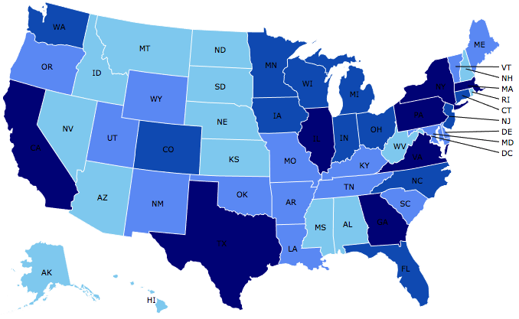
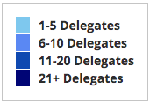
Where Are We?

Slide 5
Available NEED Topics Include:
US Economy
Healthcare Economics
Climate Change
Economic Inequality
Economic Mobility
Trade and Globalization
Minimum Wages
Immigration Economics
Housing Policy
Federal Budgets
Federal Debt
Black-White Wealth Gap
Autonomous Vehicles
US Social Policy

Slide 6
Course Schedule
Economics of Public Policy Issues
  Week 1 (3/02): Economic Update & Tariffs Geoffrey Woglom, Amherst College
  Week 2 (3/09): Trade and Globalization, Mina Kim, NEED
  Week 3 (3/16): Economics of Immigration, Robert Gitter, Ohio Wesleyan University
  Week 4 (3/23): Autonomous Vehicles, Arkadiusz Mironko, Kean University
  Week 5 (3/39): Climate Change Economics, Sarah Jacobson, Williams College
  Week 6 (4/06): Health Care Economics, Robert Rebelein, Vassar College
  Week 7 (4/13): Saving Social Security, Geoffrey Woglom

Slide 7
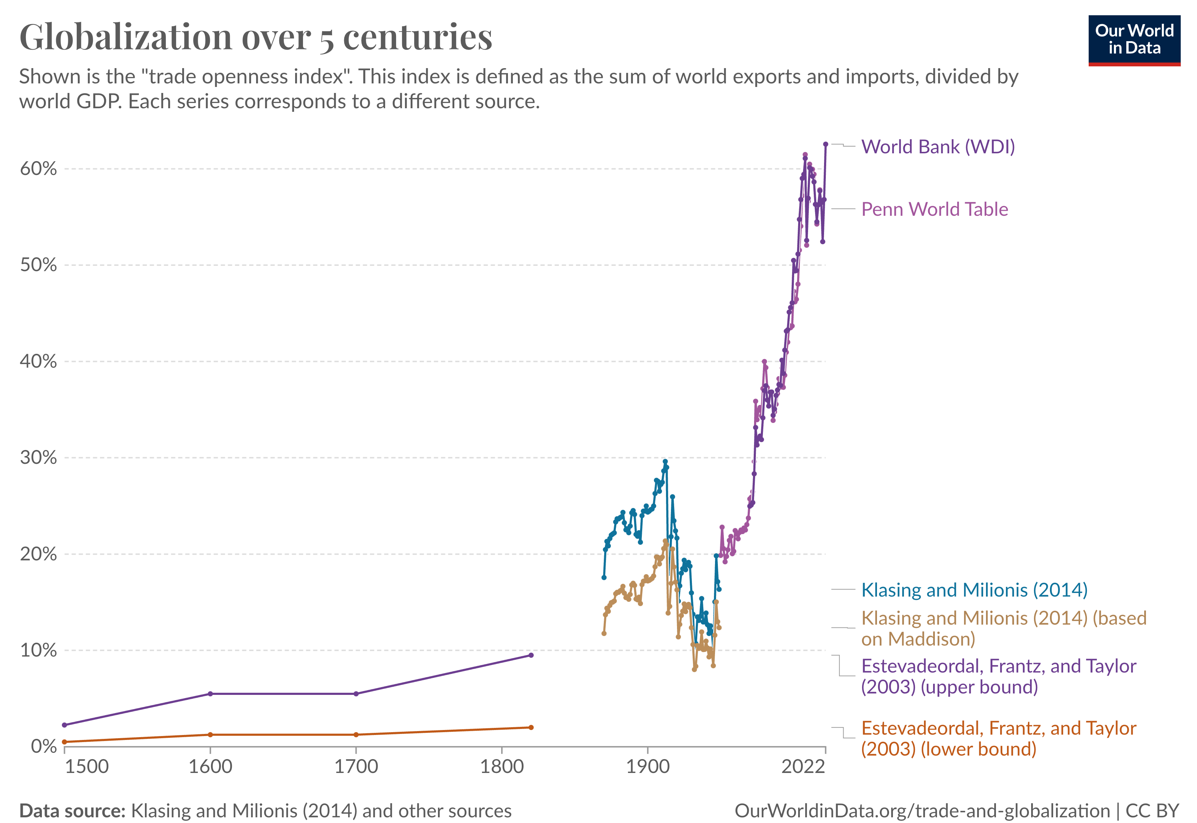
Source: https://ourworldindata.org/international-trade

Slide 8
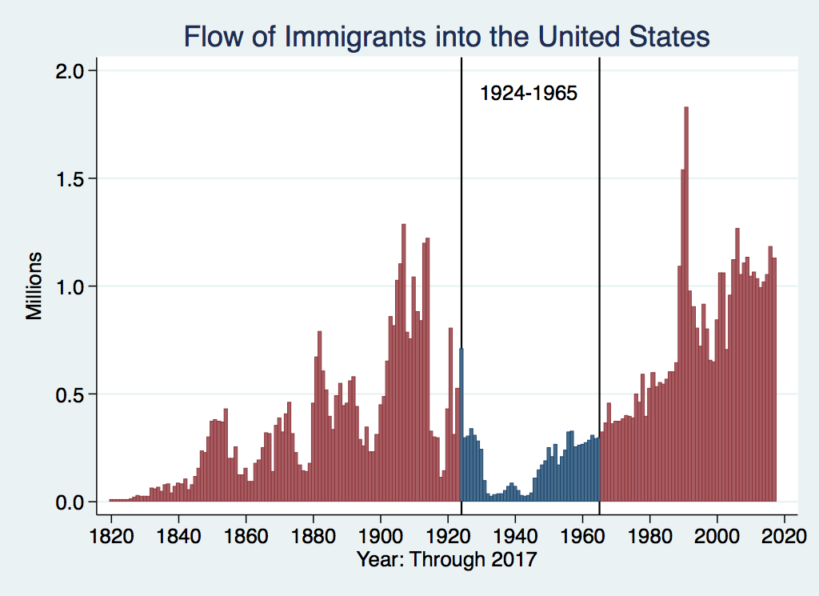
U.S. Immigration 1924-1965
Source Country | 1930-1965
Germany | 940,000
Canada | 900,000
Mexico | 610,000
Britain | 480,000
Italy | 390,000
Caribbean/ West Indies | 310,000
https://www.libertyellisfoundation.org/immigration-timeline

Slide 9
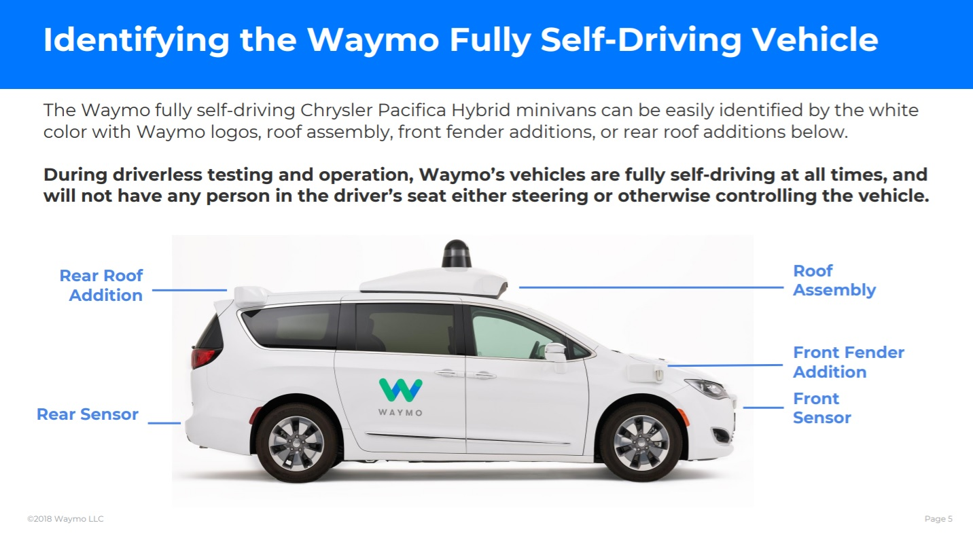
https://www.thedrive.com/tech/24340/waymo-releases-guidelines-for-autonomous-vehicle-tech-crash-response

Slide 10
How Economists Decide How Much to Fight
Climate Change: Cost Benefit Analysis
Abating greenhouse gas emissions is costly…
… but without action, climate change damages are even more costly.
Goal is not zero emissions, but efficient level that achieves a balance.
Expected costs of reducing emissions
Expected damages from allowing climate change

Slide 11
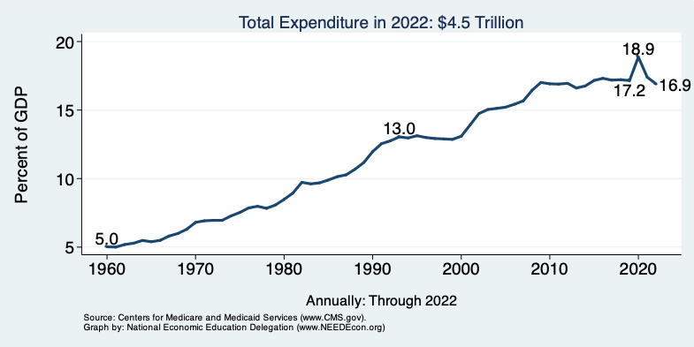
National Health Expenditure as Percent of GDP
Notes:
https://www.cms.gov/

Slide 12
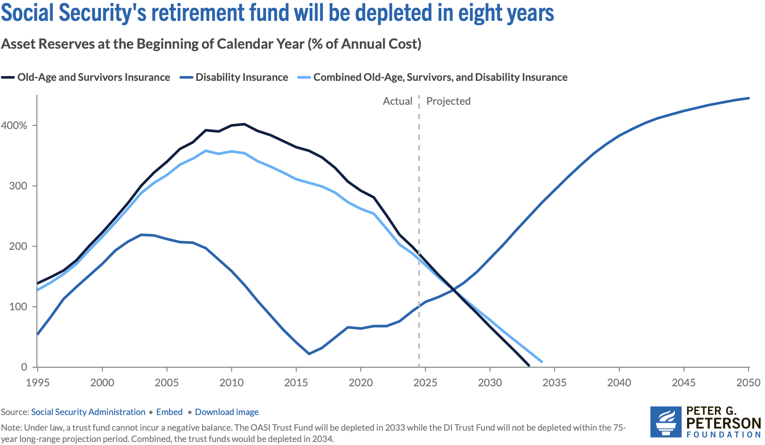
Trust Finds Are Running Out
Source: https://www.pgpf.org/article/social-security-faces-serious-financial-shortfalls-and-other-takeaways-from-the-trustees-report/

Slide 13
Submitting Questions
I encourage questions. Raise your digital hand or put questions in the chat.
We will do a verbal Q&A once the material has been presented.
Slides will be available from the NEED website tonight https://needecon.org/delivered_presentations.php.
My Google site: https://sites.google.com/view/macro-current-issues/economic-update

Slide 14
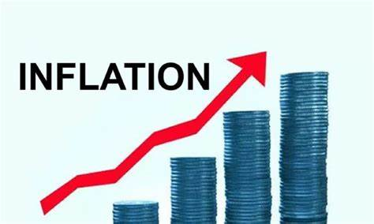

US Economy: Update
Geoffrey Woglom,
Professor of Economics
Amherst College, emeritus
March 2, 2026

Slide 15
Outline for the Talk
Overview of State of the Economy
The Fed’s Current Policy Dilemma.
Brief History and Economics of Tariffs.
Trump Tariffs pre-Supreme Court.
Prospects for Trump Tariffs.

Slide 16
The Goal of Macroeconomic Stabilization Policy
The Fed’s Definition:
Get the economy to the highest levels of GDP and employment while,
Keeping inflation low and stable, or at 2%
What about the climate change; poverty, health care?

Slide 17
Gross Domestic Product: 2025Q4 = $31.49 tr
$32.25
Less Imports
-$4.13
Plus Exports
+$3.37
Equals GDP
$31.49

Slide 18
Important Point for Later
The trade deficit is imports less exports (4.13-3.37=0.76) and reflects the fact that domestic spending (32.25) exceeds domestic production (31.49).
In order for the trade deficit to go down spending relative to production must fall
  The government deficit falls or households consume less and save more.
  Firms spend less on investment (not what we want).
  Increase production without increasing spending (hard to do)

Slide 19
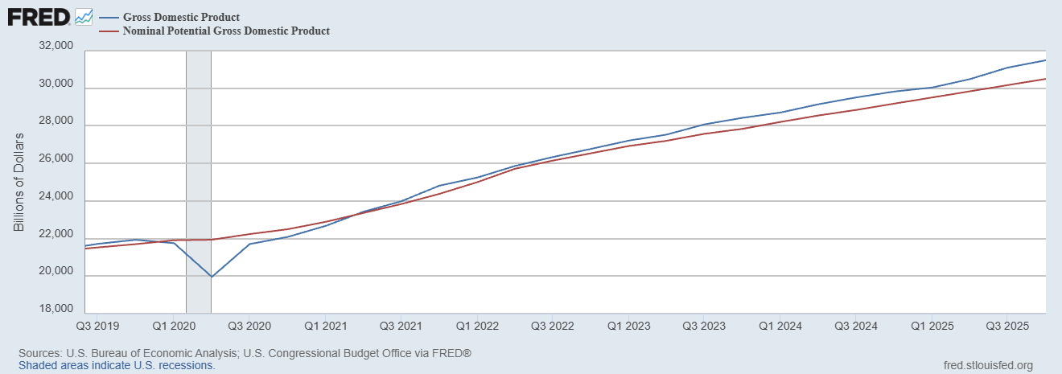
GDP and ‘Potential’ during the Recovery
Grey bar indicates recessions
Source: Fred, St Louis Fed

Slide 20
What is a Recession?
Defined by the National Bureau of Economic Research (NBER)
“The NBER's definition emphasizes that a recession involves a significant decline in economic activity that is spread across the economy and lasts more than a few months.”
Popular Rule of Thumb: Two or more, consecutive quarters where Real GDP falls. (Doesn’t always work!)
Recessions are caused by a drop in total spending (remember the consumer).

Slide 21
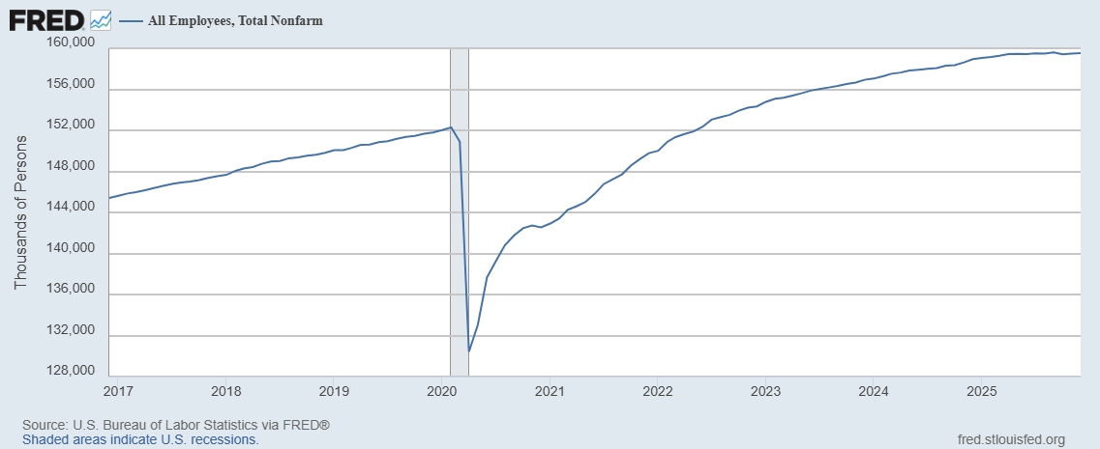
Where Have All the Workers Gone?
Aging of the Labor Force
Also, note the recent slowing in job growth.
Source: Fred, St Louis Fed

Slide 22
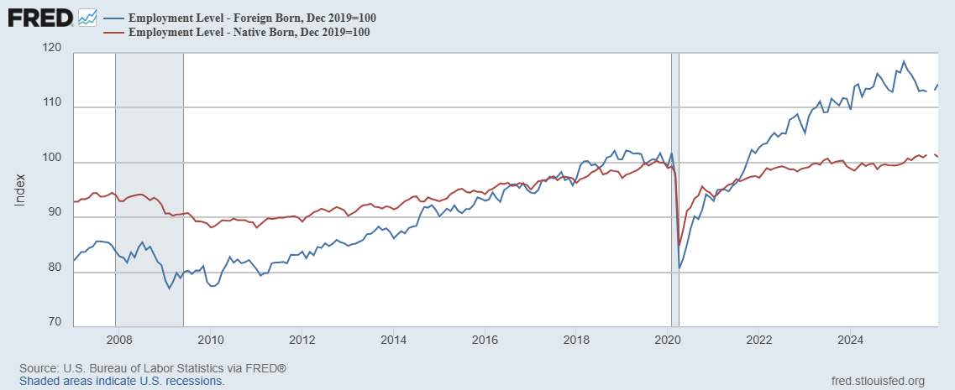
Could Have Been Worse , but for Foreign Born Workers
Between 12/19 and 3/25
NB employment fell by 100k
FB employment rose by 5000k
Since March FB employment
fell by 1100k

Slide 23
New Jobs Added per Month

Slide 24
The Kerfuffle Over the Jobs Reports
BLS conducts 2 surveys each month
  Household Survey: Unemployment Rate.
  “Establishment” Survey (workplace survey): Number of new jobs created.
August 1 Report: 73,000 jobs added July, but May and June numbers were revised down by 280,000.
Trump fires BLS director, the same day.
What is behind those “revisions?”
Want to learn more: “An Unresponsive Public is Undermining Government Economic Data,” WSJ, 9/15, at
https://sites.google.com/view/macro-current-issues/economic-update

Slide 25
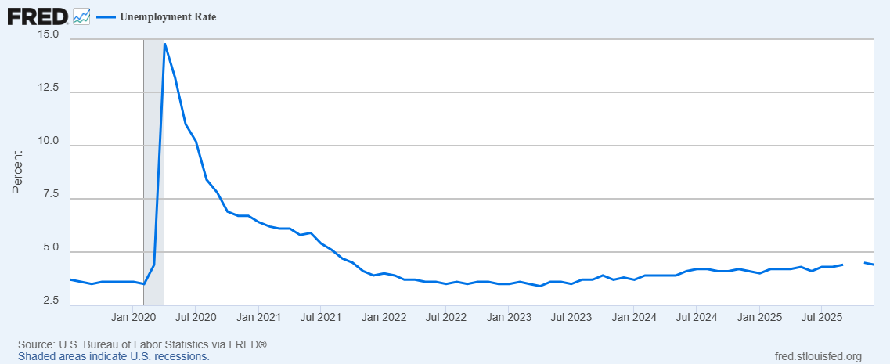
Unemployment is Near Record Lows
But, it has been rising: From 3.4 percent in 4/23 to 4.4 percent in December

Slide 26
The Real Side of the Economy is Still Good
GDP is very close to its potential.
The labor market as measured by the unemployment rate is fully recovered.
Macro Goal number 1, check
But what about goal number 2, the “nominal” side of the economy

Slide 27
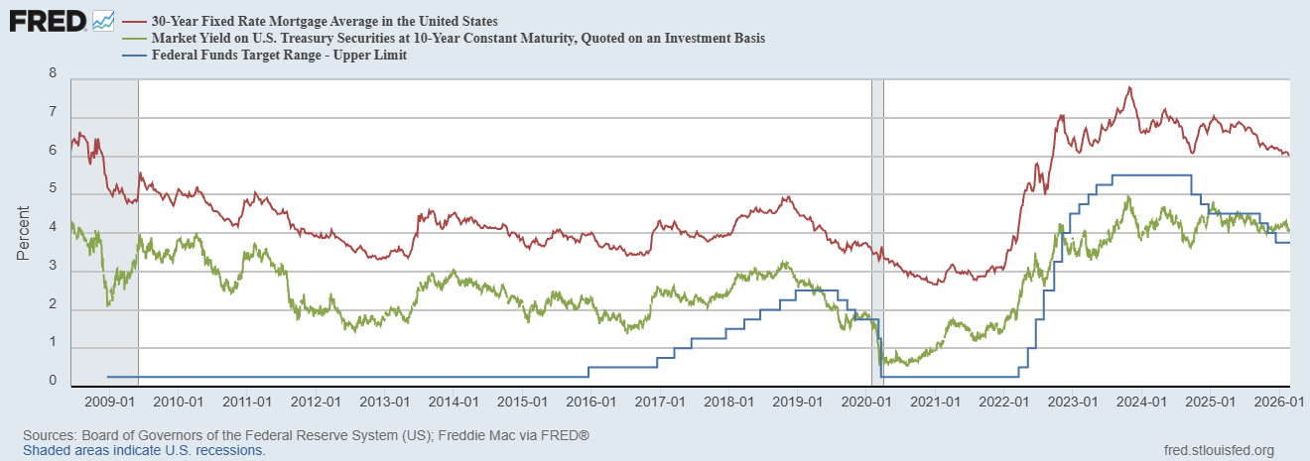
Interest Rates: Era of Falling Rates Over?
Notes:
Fed policy rate 4.5 to 4.25. Concerns with inflation

Slide 28
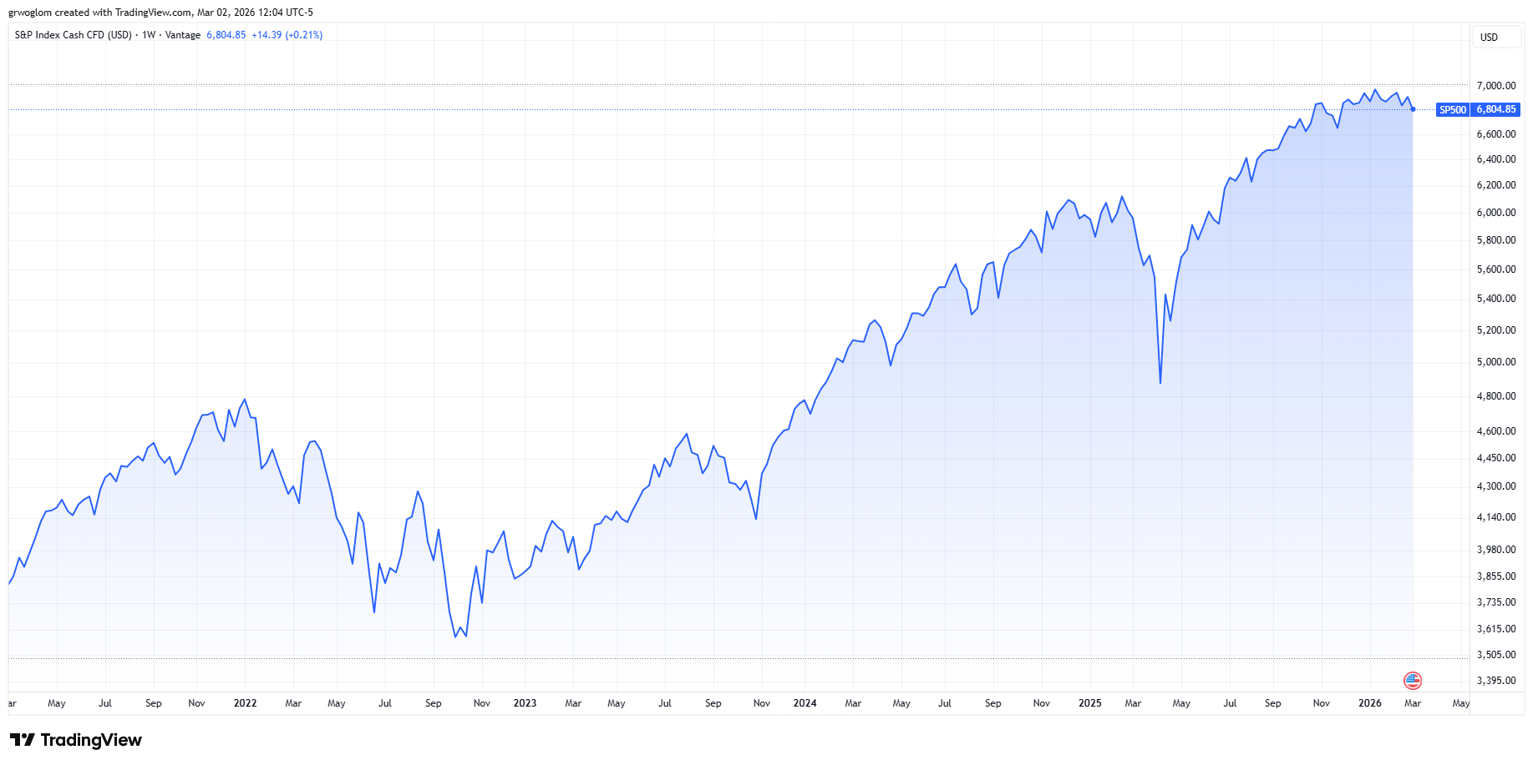
Stock Prices: Tariffs; What Tariffs?
Notes:
Since the end of 2021, lost almost 15%

Slide 29
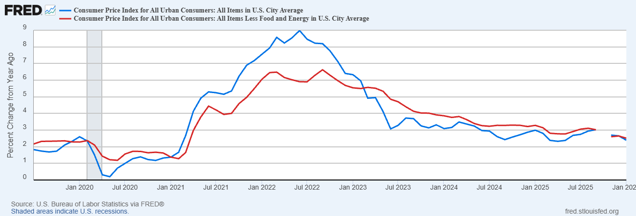
Inflation during the Recovery (CPI)
Notes:
August CPI yoy 8.3% down from 8.5 and Core 6.3 up from 6.3 in JUly

Slide 30
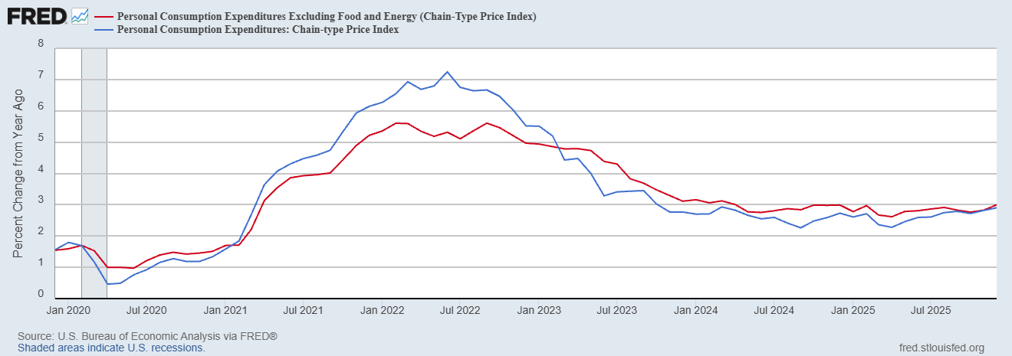
Fed’s Measure (PCE)
Inflation Accelerates 3/2021
Fed Doesn’t React until 3/2022
Progress towards the 2 % slows Spring 2024
But so far, not much sign of tariffs in inflation

Slide 31
CPI vs. PCE: Differences
CPI tends typically to be 0.3 pct point higher
December:
CPI, 2.7%
PCE, 2.9%
Core CPI, 2.6%
Core PCE, 3.0%.
https://www.morningstar.com/markets/whats-difference-between-cpi-pce

Slide 32
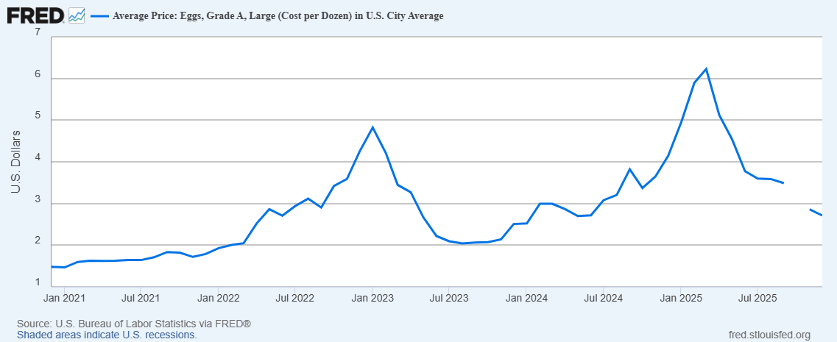
Uses of Inflation Measures
Two Reasons for Measuring Recent Inflation:
What has happened to the Cost of Living?
What is likely to happen to inflation over the next 12-18 months?

Slide 33
Wage Growth
Sources: https://www.atlantafed.org/chcs/wage-growth-tracker & BLS via https://fred.stlouisfed.org/

Slide 34
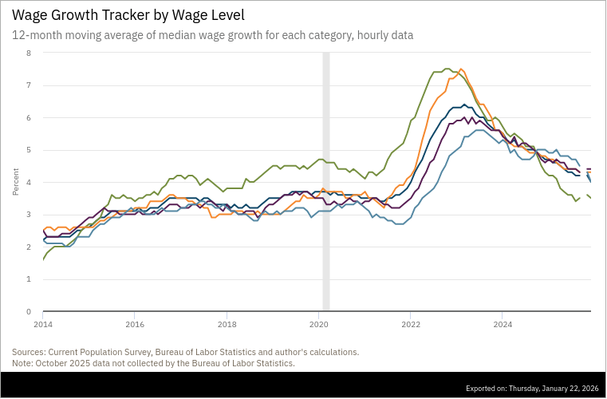
Low Wage Workers Experience

Slide 35
“Affordability”
Notes:
Weights: 3%;14%,36%, 7%, 2.5%

Slide 36
The State of the Economy & How We Got Here
The key indicators for judging the macro economy are all good
  Output and unemployment are close to their “full employment” levels
  Inflation is still a bit elevated, but much improved over 2023.
21-22
  Too much demand due to easy monetary policy and a fiscal stimulus which was probably too big
  COVID Supply disruptions exacerbated inflation.
23-present Monetary Policy Perfect
  Inflation has fallen substantially with small increase in unemployment, and we are close to the 2 percent target (unprecedented)

Slide 37
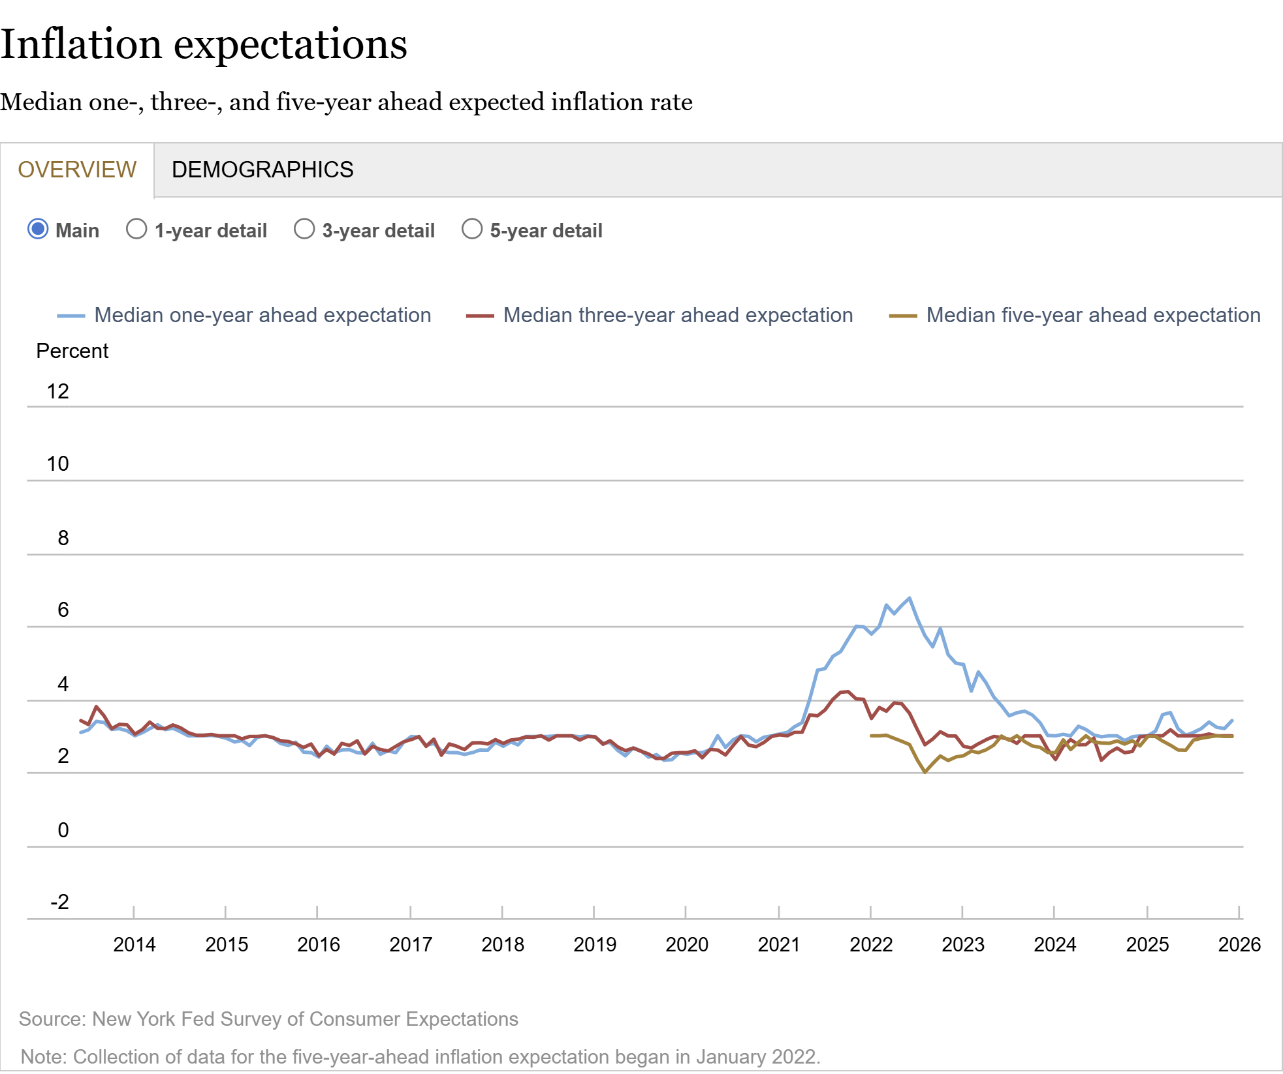
How Did the Fed Do It?
The Key to Success:
Stable Inflationary Expectations

Slide 38
The Outlook Is More Complicated
Areas of Concern:
  Consumer Spending.
  Investment Spending due to AI.
  Fiscal Policy Effects.
  Uncertainty.
  Macroeconomic Effects of the War in Iran.
  Monetary Policy: Next 4 months and the New Chair.

Slide 39
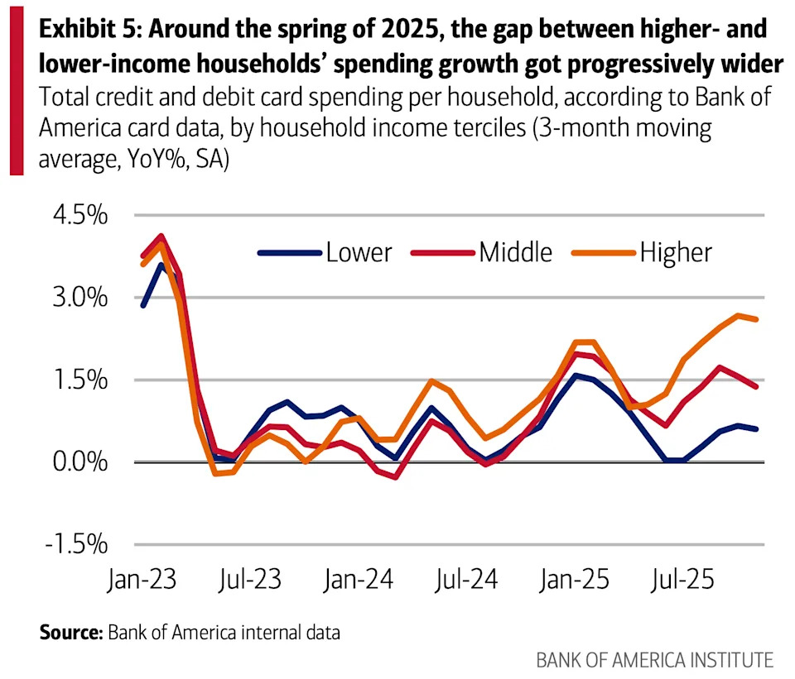
Consumption
Low-Income Consumers look vulnerable
Moody’s Top 20% account for 63% of Consumption

Slide 40
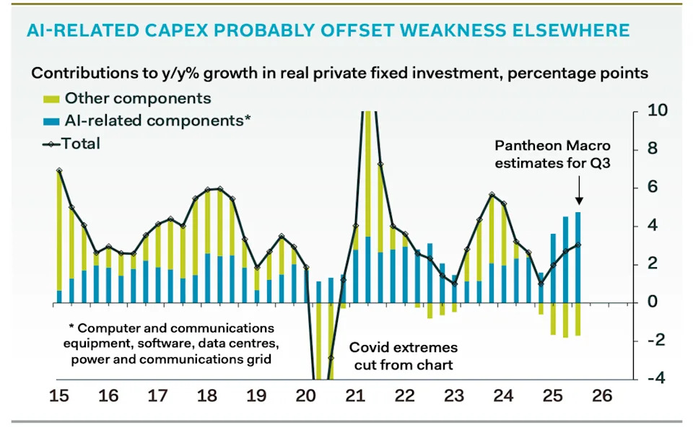
AI and Investment
AI Investment & GDP Growth
Period | GDP Growth | AI Contribution | Difference
25Q1 | 2.0 percent | 1.3 percent | 0.7 percent
25Q2 | 2.1 | 1.2 | 0.9
25Q3 | 2.3 | 0.5 | 1.8
Source: BEA & https://www.stlouisfed.org/on-the-economy/2026/jan/tracking-ai-contribution-gdp-growth
Source Parthenon: Macroeconomics

Slide 41
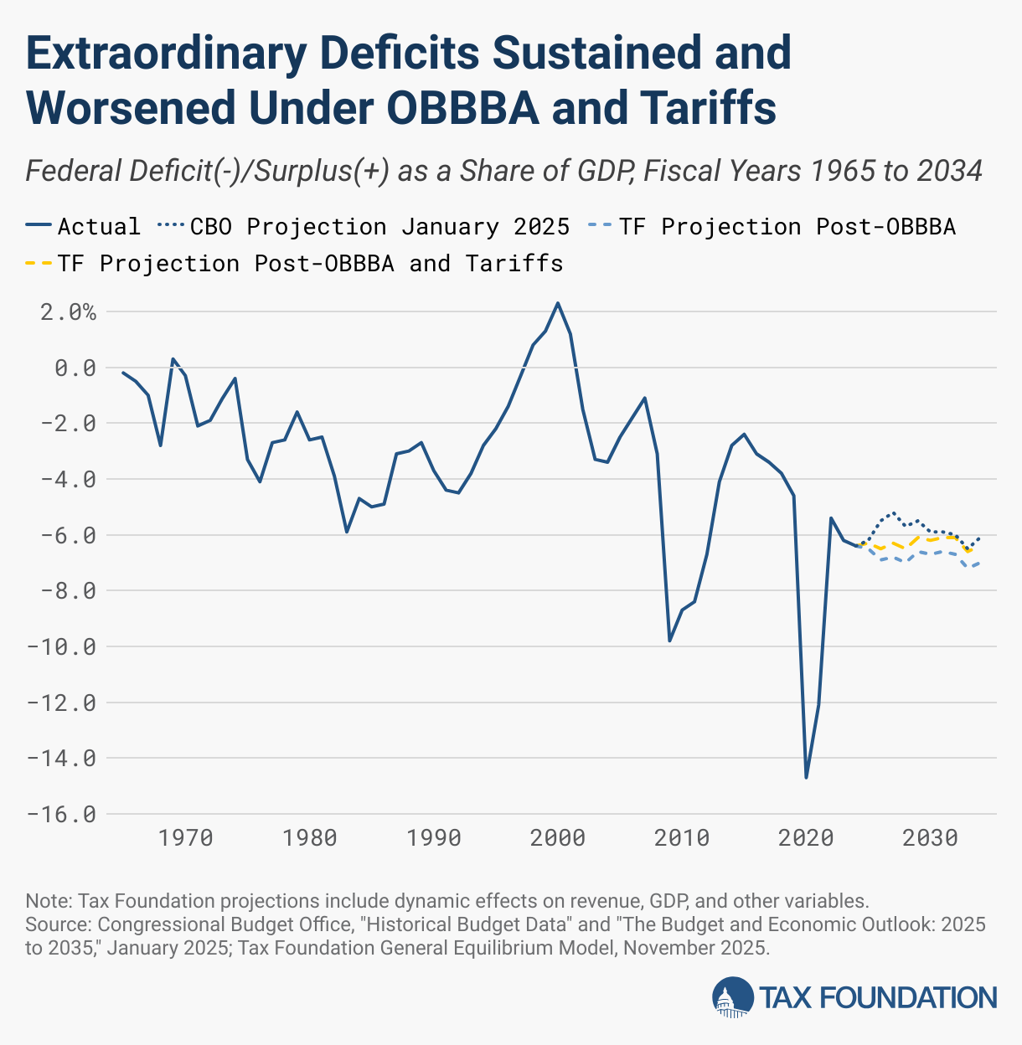
Combined Effects on the Budget Deficit
During 2025, tariff revenues collected were $264 billion.

Slide 42
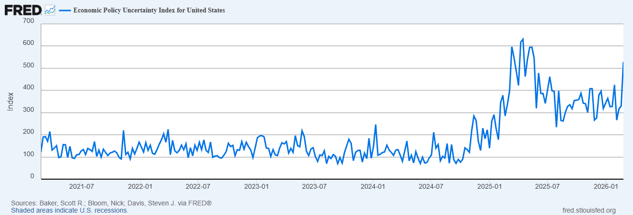
But… (Continued)
Uncertainty is Bad for the Economy’s Health (and there is a lot of it!)

Slide 43
War in Iran a repeat of 1979 ?
No
In 79 oil prices doubled, but little change in Natural Gas
So, far oil prices are only up 5%, natural gas 3% (although an oil facility in Qatar has been shut down).
The US economy use of fossil fuels is much different.

Slide 44
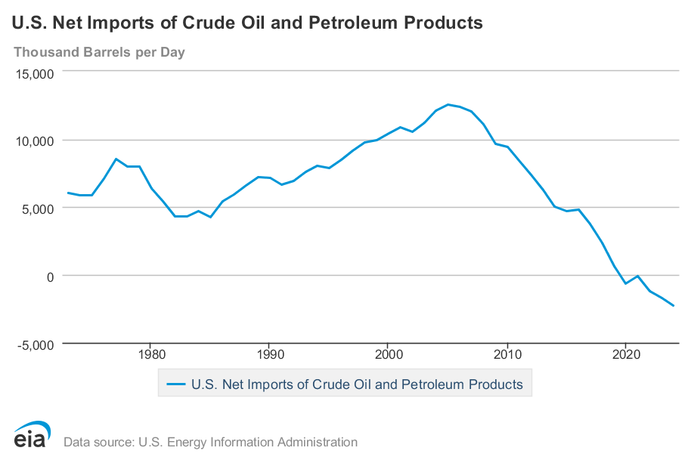
Energy Use and Foreign Dependence

Slide 45
And, then there is Monetary Policy
The Fed’s Dilemma:
To combat rising unemployment the Fed needs to lower interest rates to increase demand and spending.
To combat rising inflation the Fed needs to raise interest rates to lower demand and spending.
Successfully navigating the path between the two problems is made worse because of attacks on the Fed’s independence which have the potential to destabilize inflationary expectations

Slide 46
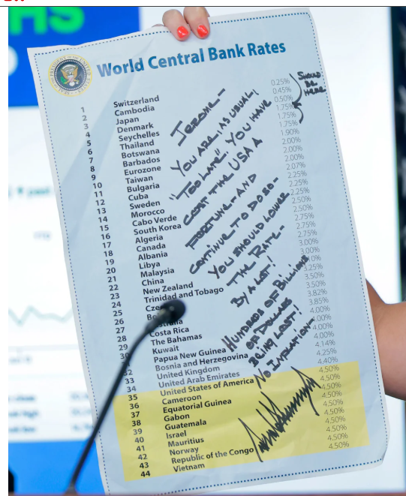
This Doesn’t Help
The irony is that the Fed would be able to lower interest rates more aggressively with no attacks.
If it appears the Fed is caving to political pressure, it will lose credibility and increase inflationary expectations.

Slide 47
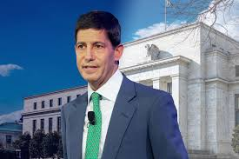
Monetary Policy after Jerome Powell ?
Kevin Warsh: Trump Nominee to replace Jerome Powell as the Chair of the Fed in May

Slide 48
Conclusion: The State of the Macro Economy
“The State of the Economy is Strong.”
Some Major Concerns Going forward.
Is the strong economy due to Trump’s policies or in spite of them?

Slide 49
A Brief Primer on Tariffs
Tariffs are a sales tax on imported goods, collected from importers.
The burden of the tariff in general falls on buyers of imports (consumers and firms) to the extent of higher prices and on the foreign country.
Economist don’t like tariffs in general because they reduce the gains from trade
  More efficient utilization of global resources: Why doesn’t Patrick Mahomes mow his own lawn
  Economies of scale for producing for large markets.
Gains to Trade Taken to a New Level with Global supply chains

Slide 50
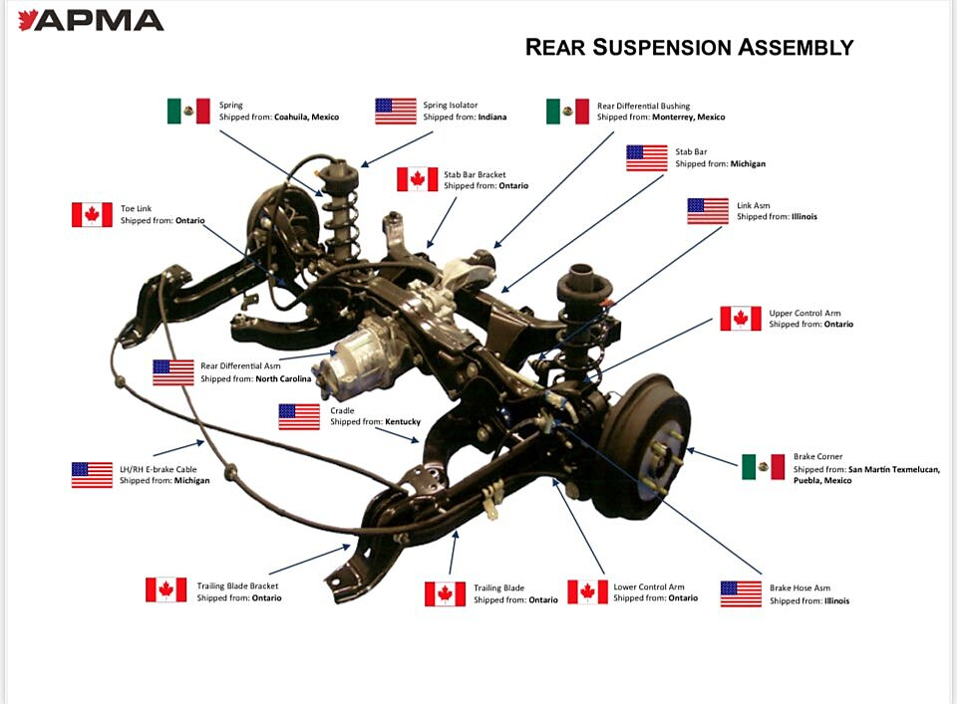
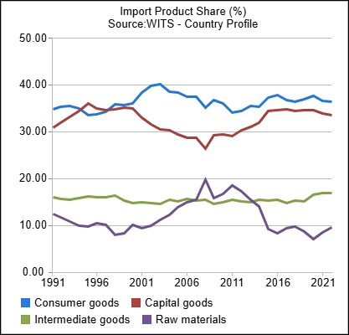
Supply Chains
US
https://www.cato.org/blog/trumps-automotive-tariffs-will-hurt-american-consumers-producers

Slide 51
Possible Economic Arguments for Tariffs
Possible arguments for tariffs
  National Defense – strategic resource. Do we need the capacity to make our own computer chips, just in case?
  “Infant” Industry.
  Temporary strategy to reduce foreign tariffs.

Slide 52
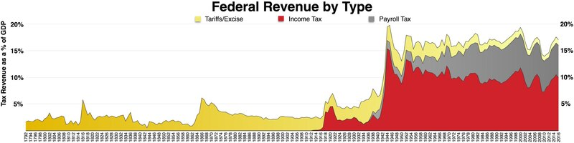
History of the Source of Federal Revenues
1913; Sixteenth Amendment. The Congress shall have the power to lay and collect taxes on incomes, from whatever source derived…
1930; Smoot-Hawley Tariff.
1935; Social Security and Payroll taxes.
https://en.wikipedia.org/wiki/File:Federal_taxes_by_type.pdf

Slide 53
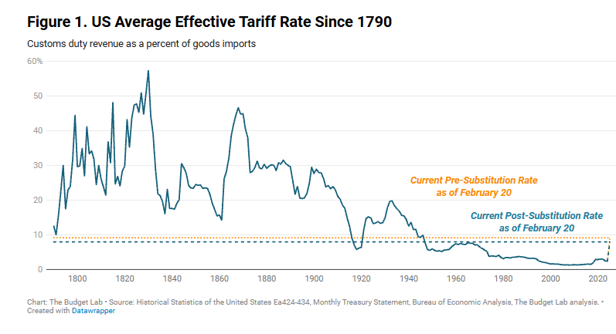
History of US Average Effective Tariff Rates
Inc. Tax
Smoot-Hawley
https://budgetlab.yale.edu/research/state-us-tariffs-april-15-2025

Slide 54
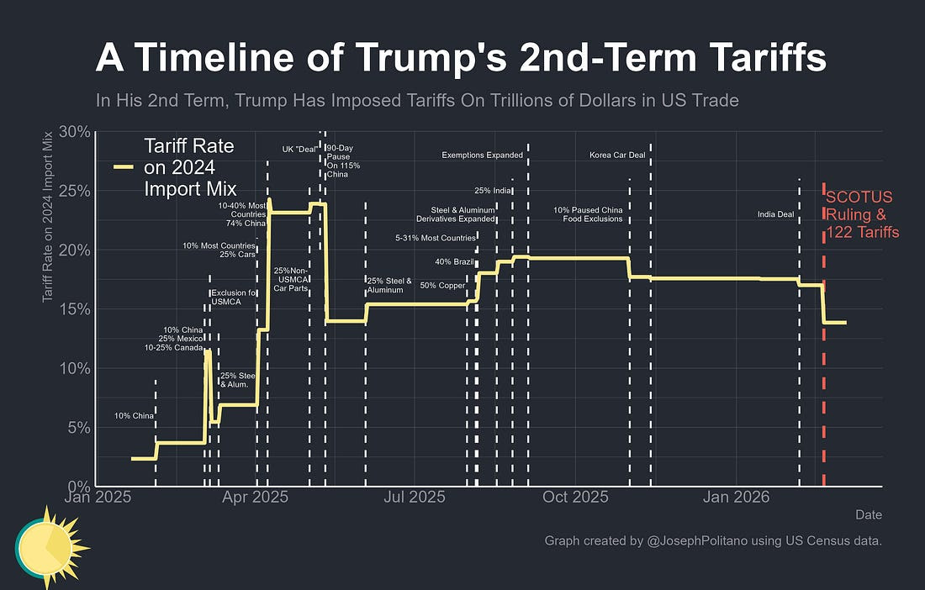
Details of Trump Tariff Policies
(https://substack.com/@josephpolitano ) of 2/21

Slide 55
The Original Reciprocal Tariffs
Reciprocal Trade Agreements Act of 1934
  President has the authority to negotiate bilateral trade agreements allowing for the reciprocal tariff reductions of up to 50% of Smoot Hawley.
  32 Bilateral trade agreements signed between 1934 and 1945.
  Sets a precedent of Congress delegating tariff authority to the President.
General Agreement on Tariffs and Trade 1947
  Outgrowth of Bretton Woods – Multilateral reciprocity.
  Average tariffs fall from 22% in1947 to 5% in 1999.
https://en.wikipedia.org/wiki/Reciprocal_Tariff_Act
https://en.wikipedia.org/wiki/General_Agreement_on_Tariffs_and_Trade

Slide 56
World Trade Organization (WTO) 1995
GATT was only a set of legal agreements and had no organizational structure.
New trade issues arose, e.g., intellectual property rights, non-tariff barriers to trade.
More efficient and “binding” dispute resolution.
China joins the WTO in December of 2001.
https://www.britannica.com/topic/General-Agreement-on-Tariffs-and-Trade

Slide 57
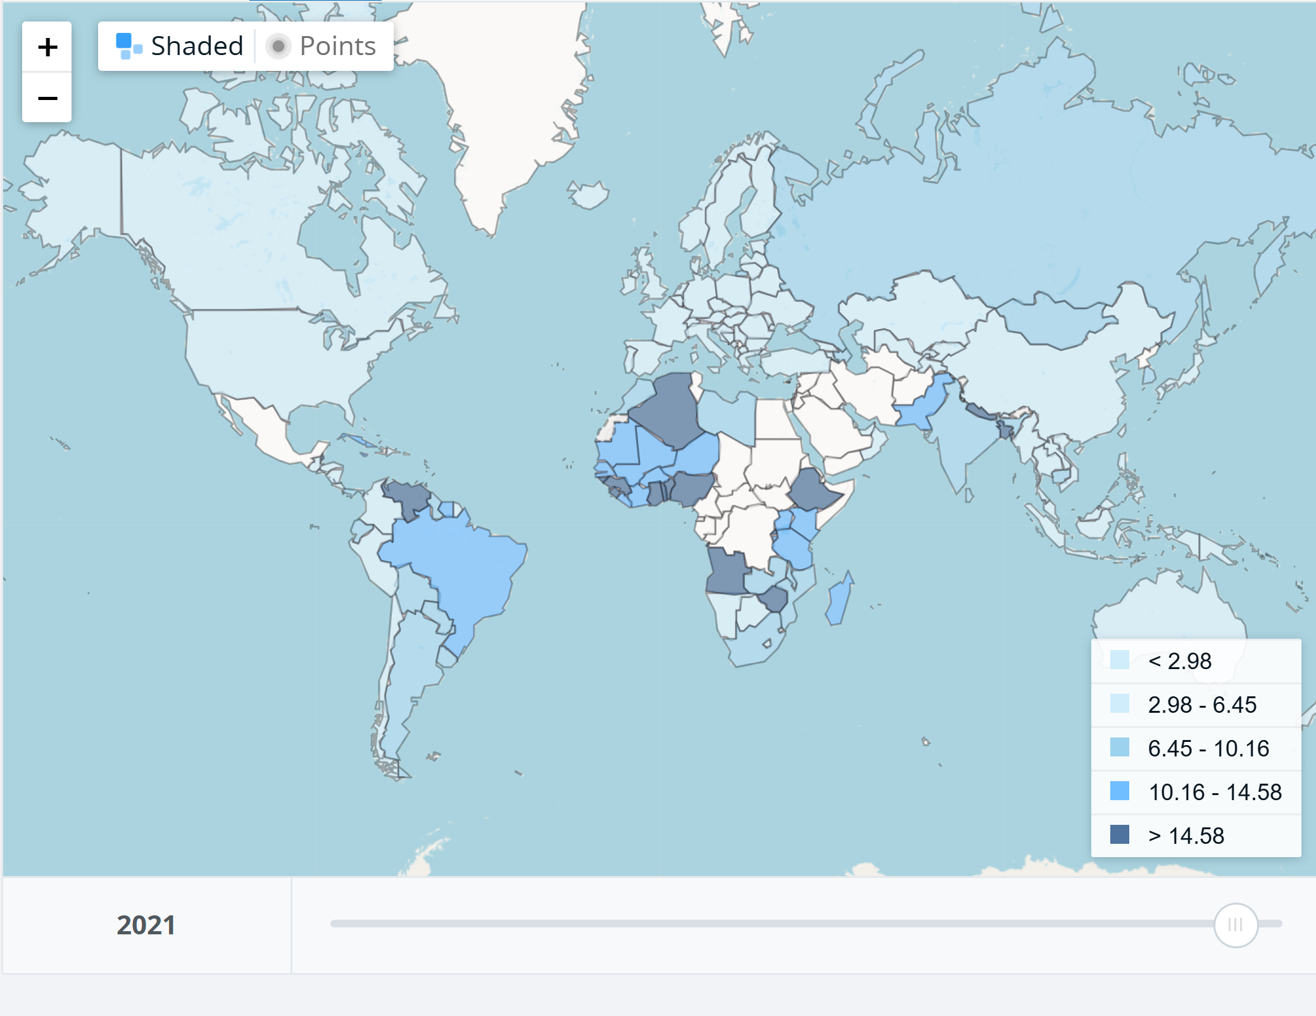
Tariffs in 2021
Key Takeaway:
Tariffs had been generally very low
1.33%
1.47%
2.31%

Slide 58
Trump Tariffs Pre-Supreme Court
Statutory Authority | Legal Basis | Scope | Agency to Investigation | Duration Limit | Tariff Rate Limit
Section 232 | Threats to national security | Sector- Specific | Commerce Department | N/A | N/A
Section 301 | “Unfair trade practices” | Country-Specific | USTR | 4-yrs (may be extended) | N/A
IEEPA | National Emergency | Country-Specific | N/A | N/A | N/A
US Trade Representative (USTR) is currently Jamieson Greer. USTR is a Cabinet-level official who is the President’s principal advisor, negotiator and spokesperson on trade policy)
Supreme Court ruled (6-3) on Friday, 2/20, that IEEPA power to “regulate” imports in a “national emergency” did not include the power to tax imports
Notes:
International Emergency Economic Powers Act

Slide 59
Who Bore the Burden of Trump Tariffs
https://libertystreeteconomics.newyorkfed.org/2026/02/who-is-paying-for-the-2025-u-s-tariffs/

Slide 60
The Distribution of the Tariff Burden
Tariffs are a Regressive Tax

Slide 61
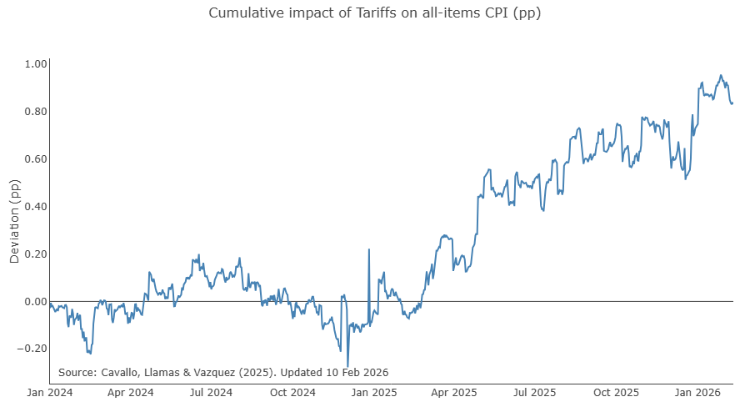
Trump Tariffs and Inflation
https://www.pricinglab.org/tariff-tracker/

Slide 62
Trump Tariffs and Tax Cuts Combined

Slide 63
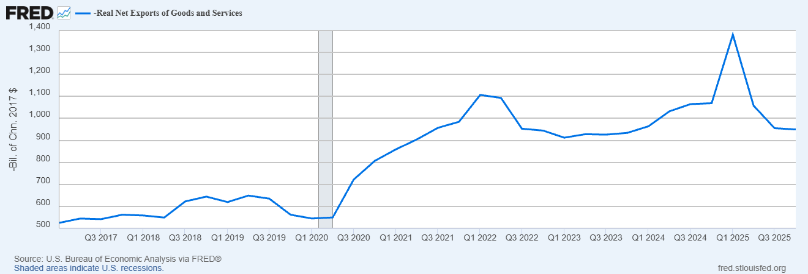
Trump Tariff and Trade Deficits

Slide 64
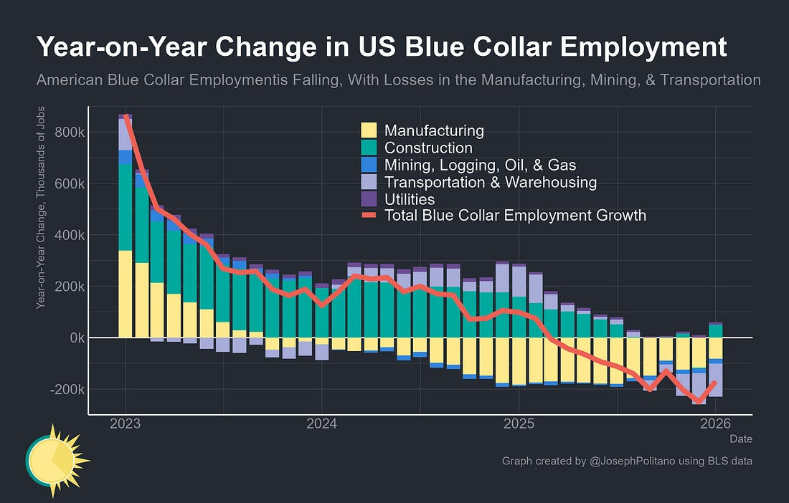
How about Blue Collar Jobs?
Politano’s Substack post:
(https://substack.com/@josephpolitano ) of 2/21

Slide 65
Impact on Investment?

Slide 66
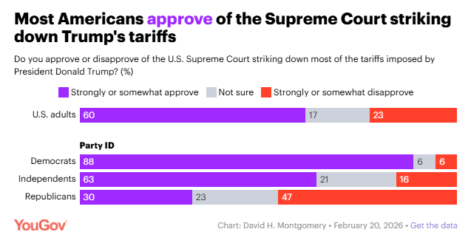
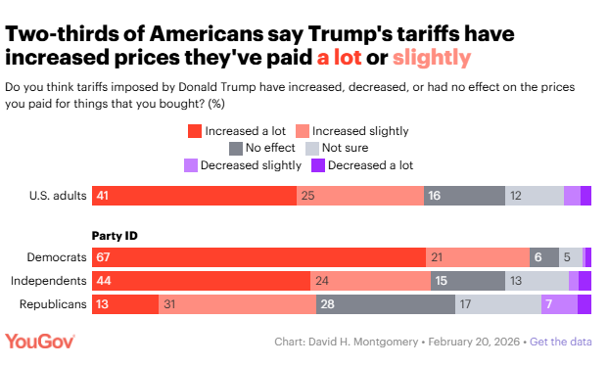
Did Scotus Save Trump from Himself?

Slide 67
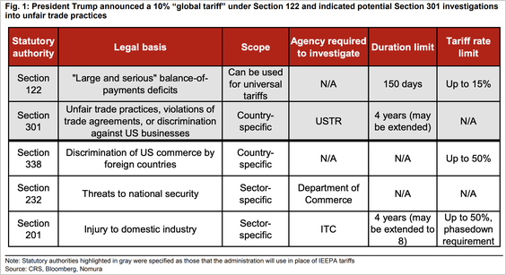
Tariff Options Available
Gray-shaded options are Trump’s announced plans

Slide 68
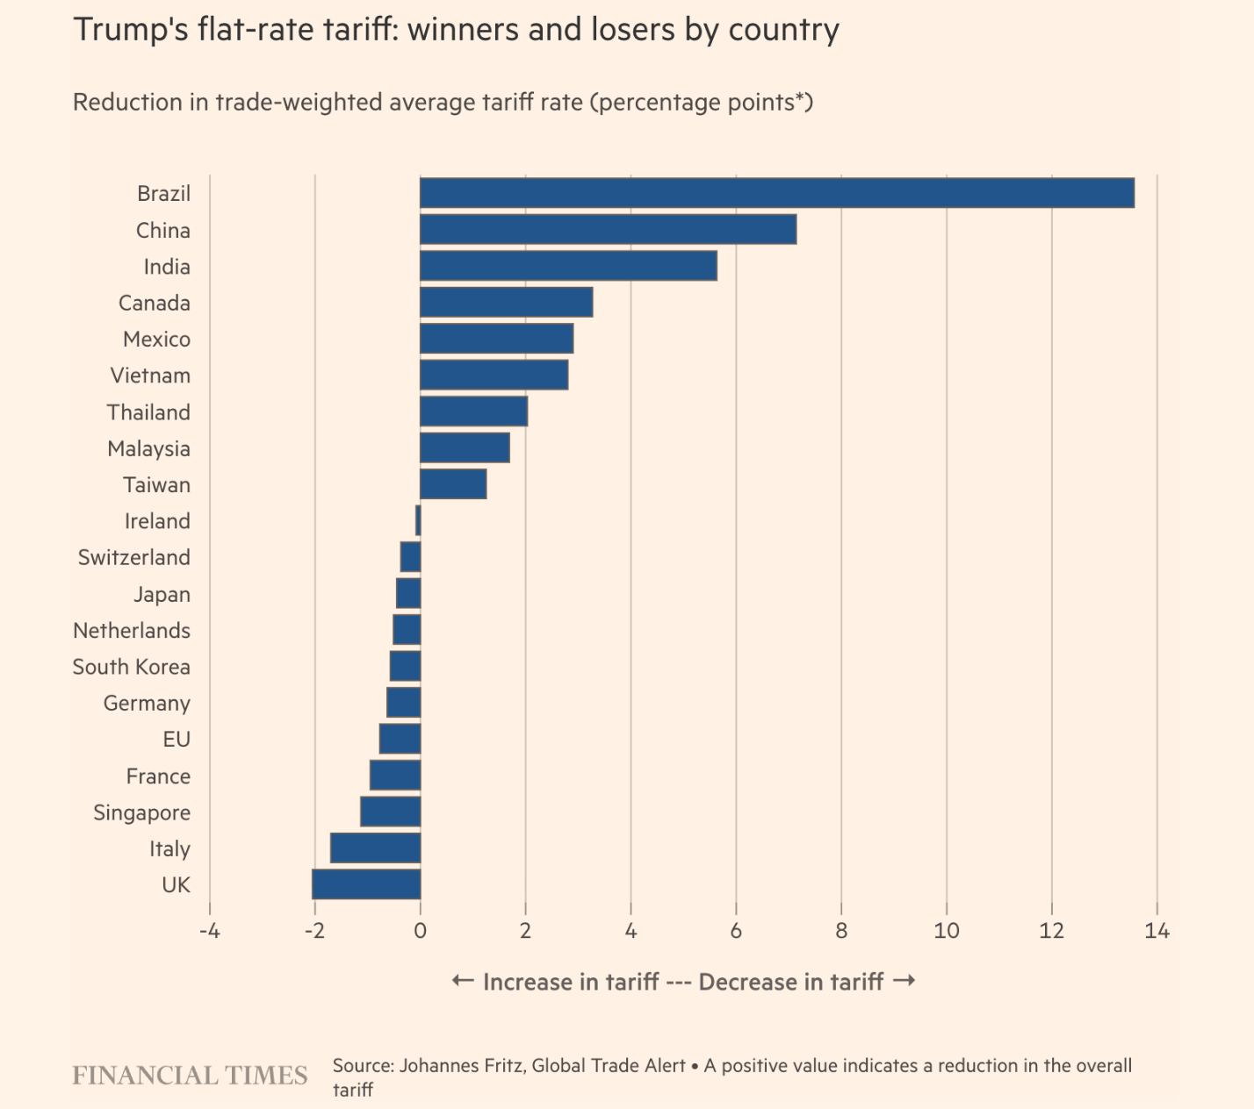
Uniform 15 percent Effect on Different Countries

Slide 69
Immediate Impact
Total Tariff Revenue Collected, $275 billion, about 50 percent from illegal use of IEEPA.
Supreme Court left it to lower courts to decide whether refunds will be required.
Refunds won’t completely undo tariffs. The refunds will be paid to “importer of record,” not the party (e.g., consumer facing higher prices) who bore the burden of the tariff.
Will firms who raised prices because of tariffs now lower them?
What will be the impact on of the new tariffs on prices?

Slide 70
Conclusion on Tariffs
Potential refunds (if they occur) will not go to those who bore the burden of the tariffs.
While the average level of Post-Scotus tariffs can approach Pre, the tariffs will be much different.
Primarily because they cannot be used against specific countries and cannot be changed quickly.

Slide 71
Source: https://ourworldindata.org/international-trade

Slide 72
Let’s Hear from You!
Geoffrey Woglom grwoglom@amherst.edu
Contact NEED: Info@NEEDEcon.org
Support NEED: www.NEEDEcon.org/donate.php

